Slide 1
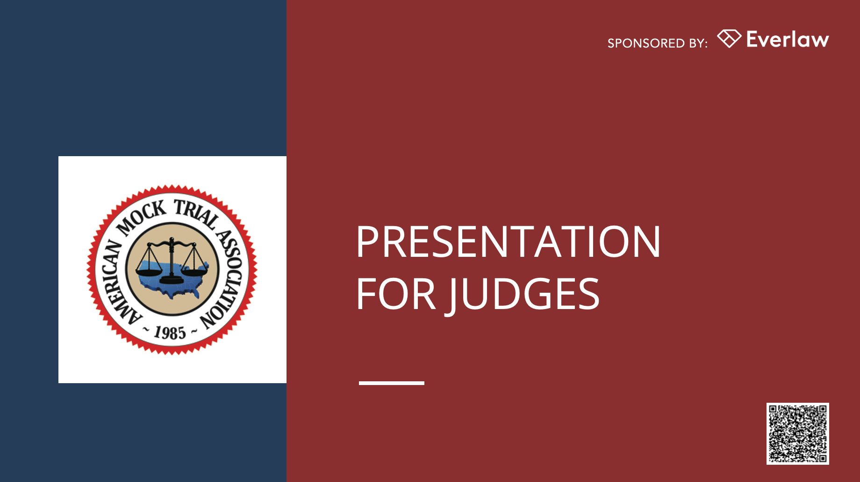


Slide 2
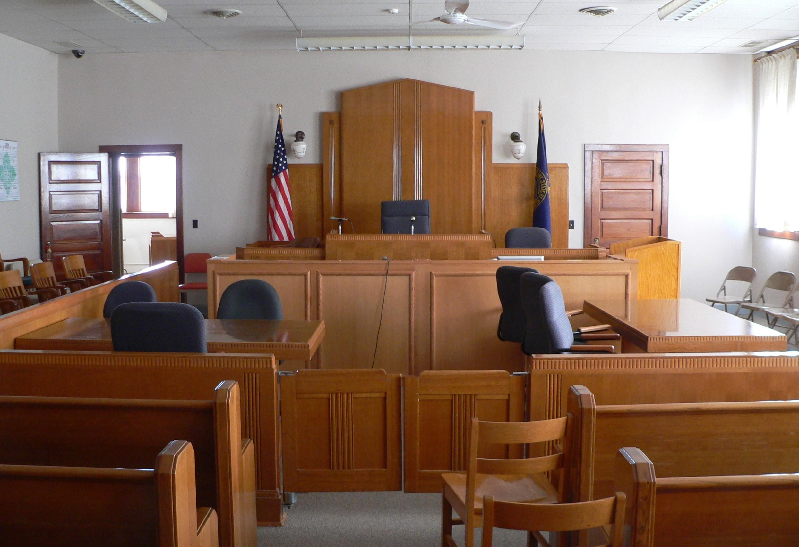
AGENDA
Trial Structure
Scoring, Presiding, & Commenting
Timekeeping & Other Rules

Slide 3
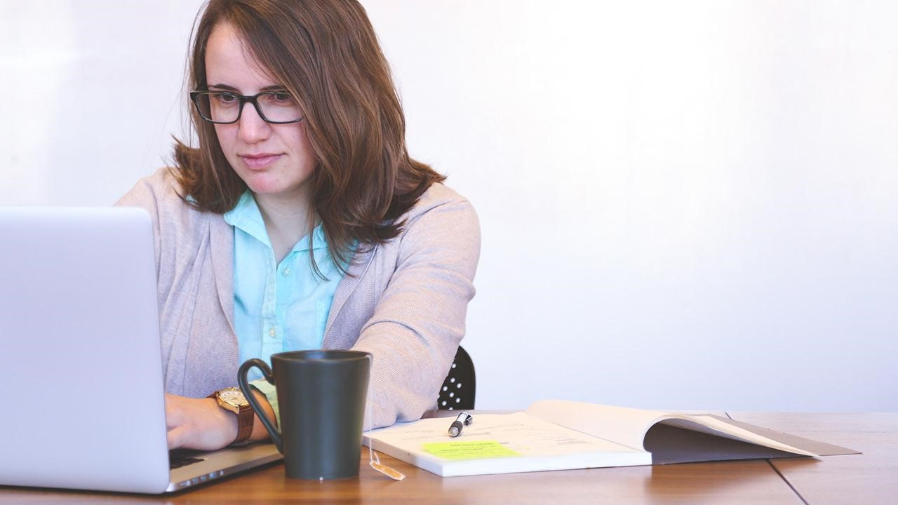
TRIAL STRUCTURE & WHAT TO EXPECT
Learning about the mock trial world

Slide 4
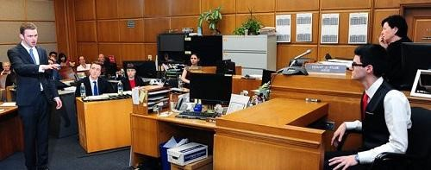
What is mock trial?
Mock trial is a simulation of a jury trial where students portray attorneys and witnesses. The trial happens in the fictional jurisdiction of Midlands, which has its own:
Case Law
Statutes
Rules of Evidence (similar to FRE)

Slide 5

State of Midlands v. Sammy Celeste & August Amber
2026 National Championship Case
Two masked individuals rob a diner, and one shoots the busboy.
The charges are armed robbery and felony murder.
The state may:
Try both defendants (in a single trial); or
Offer a plea deal to the first defendant and have them testify against the second; or
Offer a plea deal to the second defendant and have them testify against the first.

Slide 6
Case Information
Charging Document Omitted. Given the number of trial permutations, the indictment has been omitted. Prosecution teams should specify which defendant(s) is being tried.
Changing trials. Evidence available to students changes depending on which defendant is on trial and whether either testifies pursuant to a plea deal.
Informed consent to joint representation. If both defendants are on trial, they have given informed consent to joint representation and waive all hearsay objections they might have to the other defendant’s statements.
All Constitutional objections overruled. All potential consitutional issues that might normally be addressed through pretrial motion practive have been raised and overruled.

Slide 7
TRIAL COMPONENTS
Pre-trial Matters / Introductions
Opening Statements
Prosecution Case-in-Chief
Customary Break
Defense Case-in-Chief
Customary Break
Closing Arguments / Rebuttal

Slide 8
PRESIDING, SCORING, & COMMENTING
How to evaluate the round

Slide 9
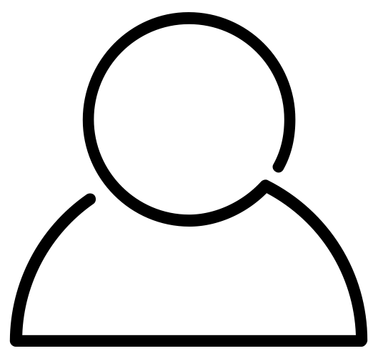
Your Role
You are here to judge the trials and evaluate the students’ performances
You will do so in panels of two or more individuals
PRESIDER
SCORER
Score
(if needed)
Provide feedback
Preside
(rule on objections, keep trial moving)
Score
Provide feedback

Slide 10
PRESIDER: RULING ON OBJECTIONS
In general, please allow students to be heard on objections. We want them to display what they do (and don’t) know.
Try not to let objection arguments drag on too long. Allowing each advocate one or two times to speak should be sufficient for ruling on most objections.
Please do not raise your own objections and do not question the witnesses yourself.
You have discretion and final say in your rulings.

Slide 11
Unique Aspects of Trials in Midlands
NO objections to openings or closings
Defense MUST open after prosecution opens (no deferred openings)
NO argued motions in limine, for a directed verdict, or mistrial
NO side bars
NO scope limitations on cross-examination (but scope is limited on re-direct and re-cross examination)
All witnesses MUST be cross examined
NO tendering of expert witnesses
NO binding law or precedents, other than those provided in Midlands statutes and the case law included in the case packet
NO Constitutional objections
Differences from real-world trials

Slide 12
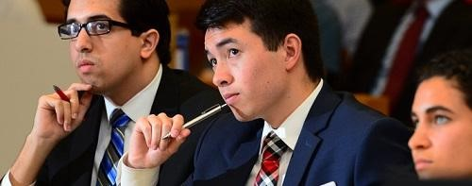
Movement Throughout Trial and Exhibits
While other jurisdictions may differ, please allow students to move throughout the well and use demonstrative aids (subject to objections).
Students may elect to provide exhibits to the Court and witnesses via exhibit binders they have provided, which may be located at the bench and witness stand.

Slide 13
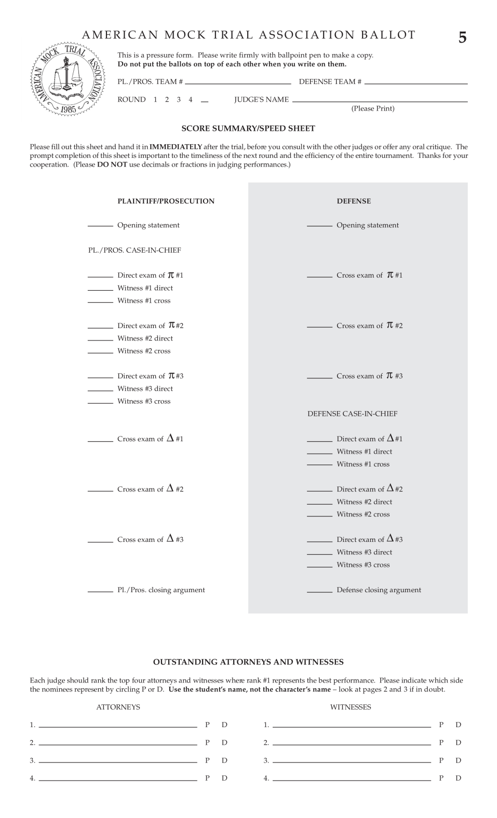
The Ballot
Ballot has 3 carbon copy pages
Don’t write on the full stack!
Be sure to set each page directly on the table to write

Slide 14
Ballot Organization
Prosecution (π)
LEFT
Prosecution
RIGHT
Defense
Defense scores are shaded
Defense (Δ)

Slide 15
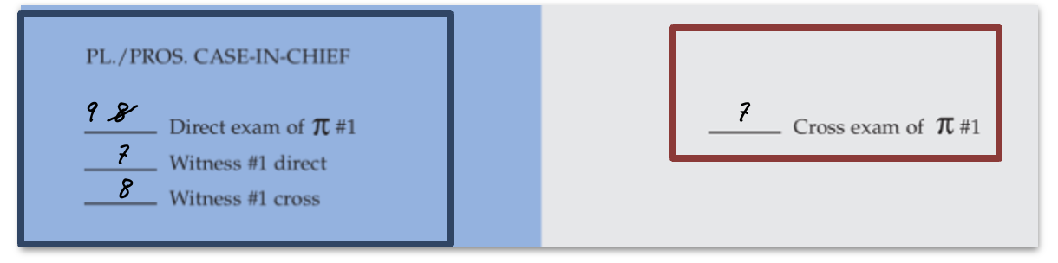
Using the Ballot
Prosecution
Defense
After each witness has finished, you should have four scores filled out:
-Directing attorney
-Witness on direct
-Witness on cross
-Crossing attorney
Editing: If you need to change a score, cross it off and re-write the modified score next to it clearly

Slide 16
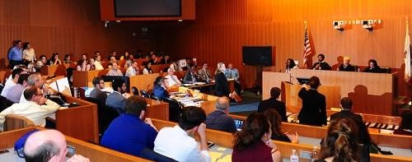
Remember: Witnesses are scored twice – on Direct AND Cross!

Slide 17
No Separate Scores For:
Pre-trial matters
Re-direct examinations
Re-cross examinations
Rebuttal
Objections
Instead, you can consider these in the corresponding scored portion (for example, the rebuttal may influence your score for closing).

Slide 18
Score as you go & write scores on
the ballot!

Slide 19
You’re not reaching a verdict.
Score on your own (don’t confer with co-judge on scores).

Slide 20
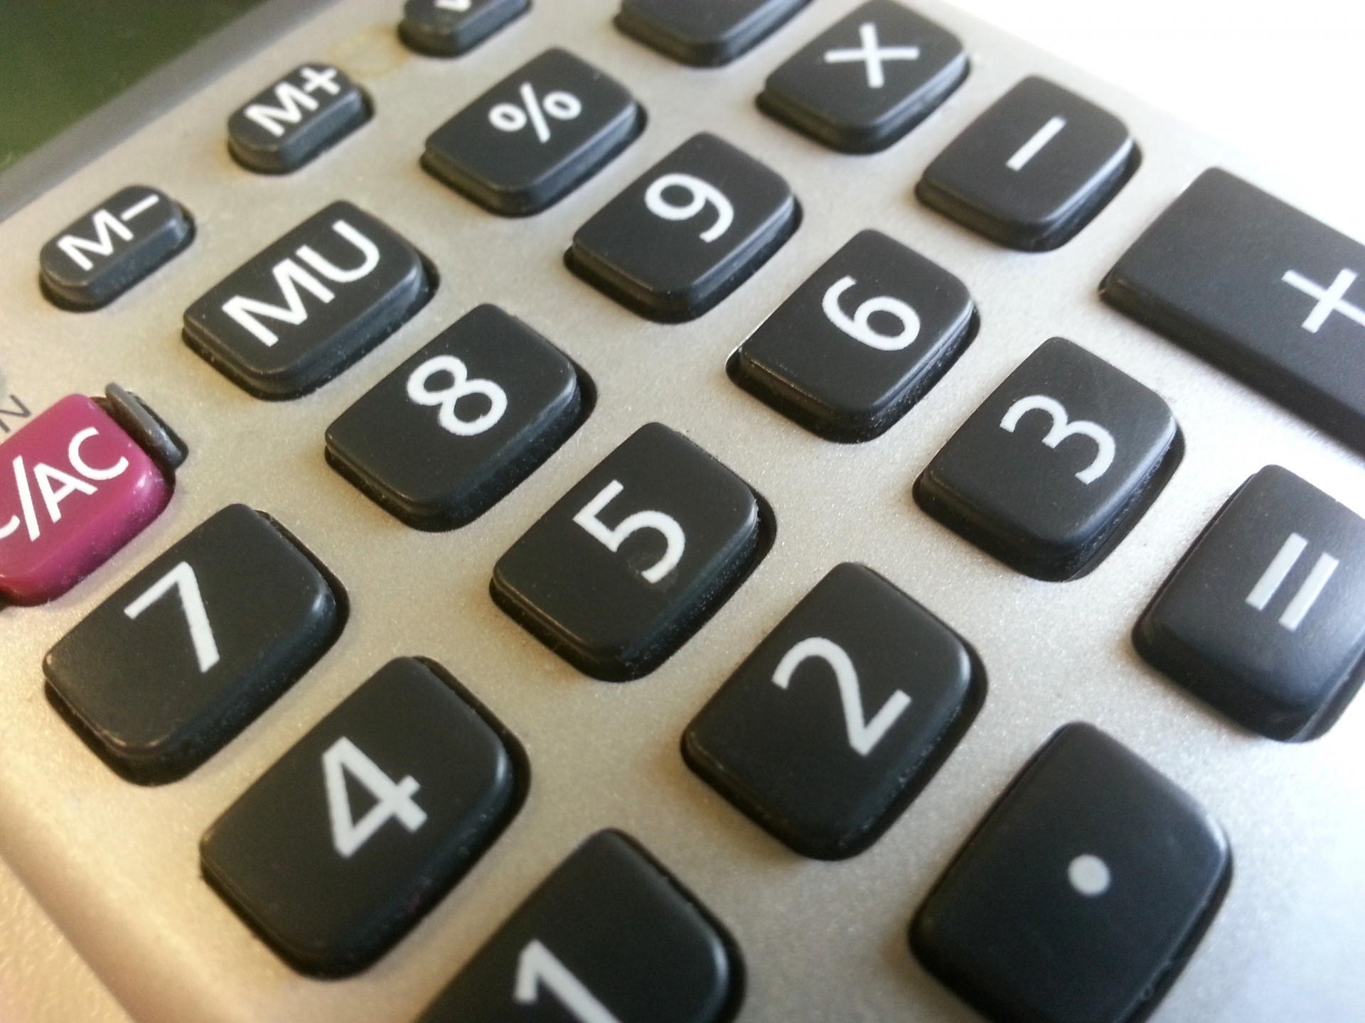
Scoring Framework
RANGE
Score from 1-10, with 10 being the best score
No decimals, only whole numbers
No zeros*
* Unless the role didn’t occur
DIFFERENTIATE
Use scores to differentiate performances
Scale doesn’t matter, just be internally consistent

Slide 21
Scoring Framework
What TO Consider
Presentation/poise
Knowledge of the facts/rules of evidence
Ability to present a case on direct/control witnesses on cross
Witness credibility and character
What NOT to Consider
What you saw in prior trials
Which side would win in a real trial (merits)
Student health precautions (like masks)
Attire of attorneys or witnesses*
*Witnesses are allowed to wear costumes, but are not required to do so

Slide 22
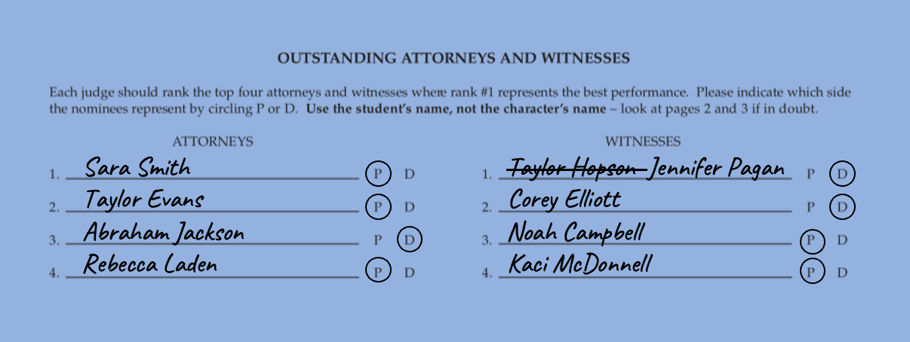
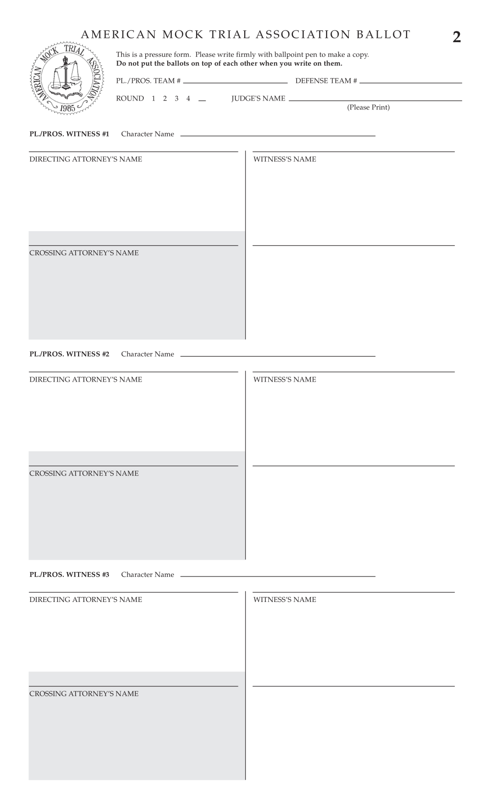
Individual Awards
Write the WITNESS NAME name, not the CHARACTER NAME
Circle P or D
Must fill out all four slots

Slide 23
Scoring Consistency and Student Experience
Please apply criteria for excellence consistently across all competitors, focusing on performance quality and competency.
Please do not consider students’ race, gender, age, sexual orientation, or other similar factors when scoring.
Please help us make this activity a warm, welcoming and educational experience for all students. Feedback should, where appropriate, be encouraging, and should focus on areas that students can improve in future rounds.

Slide 24
Invention of Fact
(Almost) All Witnesses
Limited to sworn affidavits and reports (and materials relied upon) and reasonable inferences on direct examination.
On cross examination, must not contradict their affidavit….
…but if an attorney asks a question outside of the affidavit, then the attorney is stuck with the answer.

Slide 25
Invention of Fact
Limited Defendant Exception
When the defendants were interviewed, there were two questions they refused to answer.
A defendant (if not offered a plea deal and called by the defense) may invent any answer to those two questions that does not contradict their other interrogation answers.
A defendant who receives a plea deal (and is no longer therefore a trial defendant) may not invent.

Slide 26
Invention of Fact
In Trial Remedies
This competition has NO “invention of fact” objection when teams believe that a witness has improperly invented facts.
Instead, the rules allow students to attempt to impeach the witness during cross examination (via contradiction or omission).
Each scoring judge determines whether testimony offered by a witness is a reasonable inference or an invention of fact. If you believe the impeachment was effective in showing there was an invention of fact, then score accordingly on your blue ballot.

Slide 27

PROVIDING COMMENTS

Slide 28
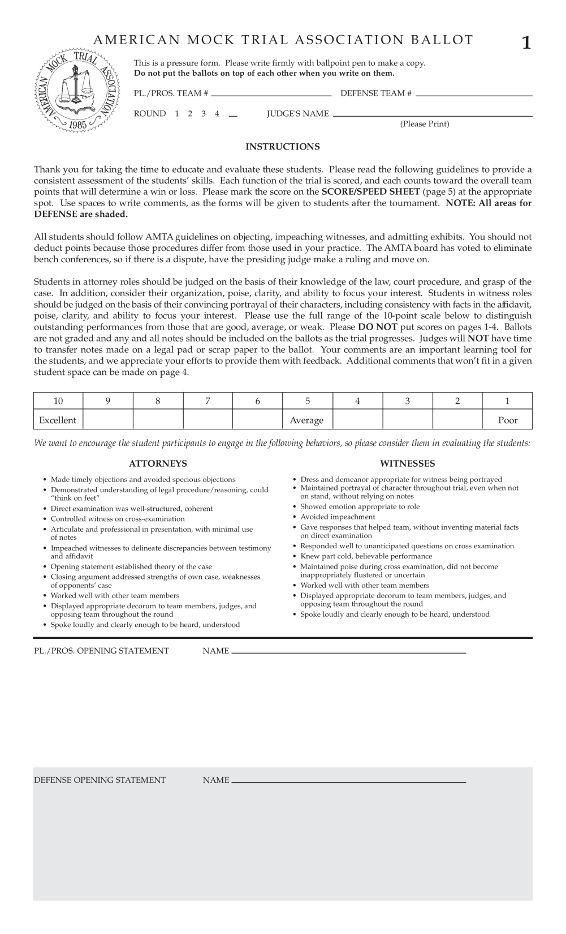
Giving Comments
All scoring judges should receive four comment sheets (also carbonless copy paper, so don’t write on the full stack!)
Students fill out their names / roles / team code

Slide 29
Giving Comments
Prosecution
Use blank spaces to write comments
Non-shaded refer to Prosection parts
Shaded is for Defense
Find student names for individual awards
Defense

Slide 30
Giving Comments
Students will receive copies of the written comments after the competition
After the trial is complete, please provide a few minutes of general verbal feedback

Slide 31
TIMEKEEPING & OTHER RULES

Slide 32
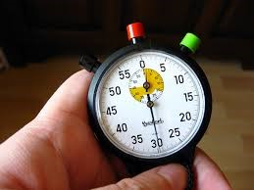
Timekeepers
Students act as timekeepers
The trial has a 3-hour time limit, and each part of the trial has specific time limits
Please enforce time limits when informed of them to avoid exceeding the “all-loss time”

Slide 33
Anonymity & Spectators
Students’ school identity should remain anonymous until after the round
All trials are public; don’t assume the identity of the teams based on who enters the courtroom

Slide 34
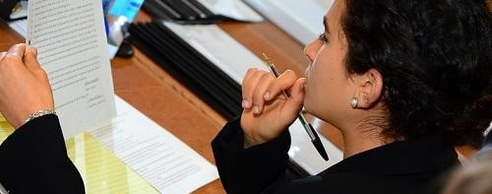
Conflicts
If you have already judged a team at this particular tournament, please DON’T start the trial; inform tournament staff
If you are affiliated with the team (e.g., your child is on the team), please DON’T start the trial; inform the event representative

Slide 35
What happens next?
Questions & Judging Assignments!

Slide 36

Thanks!

